Slide 1
Simple Linear Regression

Slide 2
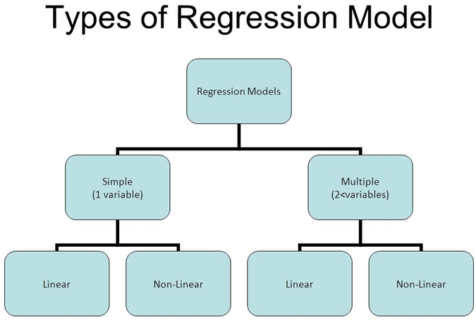

Slide 3
Regression models are built for 2 reasons:
  either to explain the relationship between an exposure and an outcome — We will refer to these as explanatory models
  or to predict the outcome based on a set of independent variables — We will refer to these as prediction models

Slide 4
Simple Linear Regression
is a statistical method that allows us to summarize and study relationships between two continuous (quantitative) variables
One variable, denoted x, is regarded as the predictor, explanatory, or independent variable.
The other variable, denoted y, is regarded as the response, outcome, or dependent variable.
Not used to study deterministic relationship
  Circumference = π × diameter
  Fahr = 9/5 Cels + 32
Used to study statistical relationships, in which the relationship between the variables is not perfect.

Slide 5
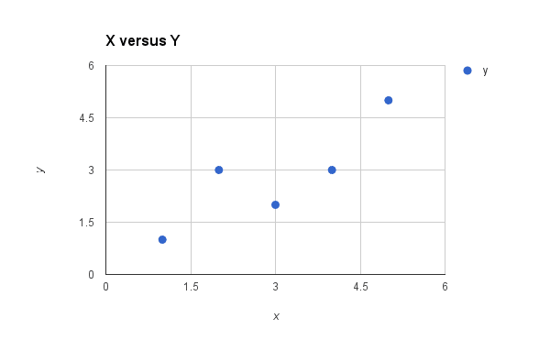
Simple linear regression
we want to model our data as follows:
  y = b₀ + b₁*x
y- dependent var
x- independent var
b₁- coefficient (feature weights)
  need to estimate
  Population slope
b₀- constant-
  need to estimate
  b₀ is called the intercept
b₀ & b₁ are model’s parameters

Slide 6
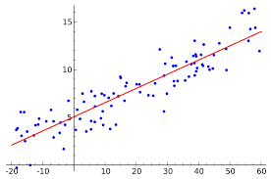
Constant & Coefficient meaning
Salary- dependent var
No of experience- independent var
Constant- if no of experience is 0, it tells about salary , sometimes may not be valid for the problem i.e. x=0 may not be relevant for the problem like if x is height and y is weight.
Coefficient (slope)- as the experience grows how fast salary will increase

Slide 7
The goal is to find the best estimates for the coefficients to minimize the errors in predicting y from x.
There may not exists the complete fit to a straight line so we can assume that there is an error (noise) in the data
  y = b₀ + b₁*x+ ϵ🡪 random error
We assume that this is the function from which the points are generated so we can think of there is an underlying line from which these points are generated after accounting for some error.
We are assuming Expected value of E(Y|X) follows this equation. This equation is the equation of the population line i.e. from which examples are actually drawn. So E(Y|X) = b₀ + b₁*x
And we assume this error has mean of 0 and some standard deviation.
and given the data points we are trying to find out b₀ and b₁that is b₀ Hat and b₁ hat so y= b₀ hat + b₁hat*x is the equation that we are trying to come up with that is the estimate for actual target function (y = b₀ + b₁*x+ ϵ).
We will optimize certain things to get this estimate w.r.t the training examples.
  We try to get the values of b₀ hat and b₁ hat so that the sum of squared error is minimized and then the equation y= b₀ hat + b₁hat*x is called least squares line.
So we will see how for the given points we will come up with the least square line.

Slide 8
Assumptions about the error
The given data points may not form a perfect line so
w.r.t. every example there is the value of the error
We will make some assumptions about the error
  ϵ_{i} is a normally distributed random var, with mean zero and variance σ² so this type of noise is Gaussian noise.
  E(ϵ_{i})=0.
  σ(ϵ_{i})= σ
  Errors (ϵ1, ϵ2, ϵ3…) are uncorrelated and independent.
d1 y1 = b₀ + b₁*x1+ ϵ1
d2 y2 = b₀ + b₁*x2+ ϵ2
d3 y3 = b₀ + b₁*x3+ ϵ3
.
.
.

Slide 9
Consequence of assumptions on error on y
y_{i} = b₀ + b₁*x_{i}+ ϵ_{i}
E(y_{i}) = E(b₀ + b₁*x_{i}+ ϵ_{i}) = b₀ + b₁*x_{i}
V(y_{i})= v(b₀ + b₁*x_{i}+ ϵ_{i})= v(ϵ_{i})= σ²
ϵ_{i} is a normally distributed random var, with mean zero and variance σ² and all ϵ_{i} are independent.
y_{i} is a normally distributed random var, with mean b₀ + b₁*x_{i} and variance σ² and all y_{i} are independent.
Given a dataset, while fitting a simple linear regression model, how to check if the dataset is satisfying basic assumptions- model adequacy checking

Slide 10
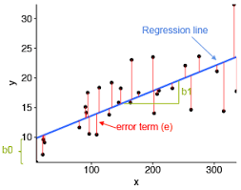
Least squares estimation of parameters
prediction error/residual error
  y_{i}-y_{i}’
Finds a line which has smallest sum of square🡪 least square regression line
  Sum (y_{i}-y_{i}’)²
Goal
  minimize the sum of the squared prediction errors
Why square?
  if we didn't square the prediction error to get the positive and negative prediction errors would cancel each other out when summed, always yielding 0.
Line fitted by least square is the one that makes the sum of squares of all vertical discrepancies as small as possible.

Slide 11
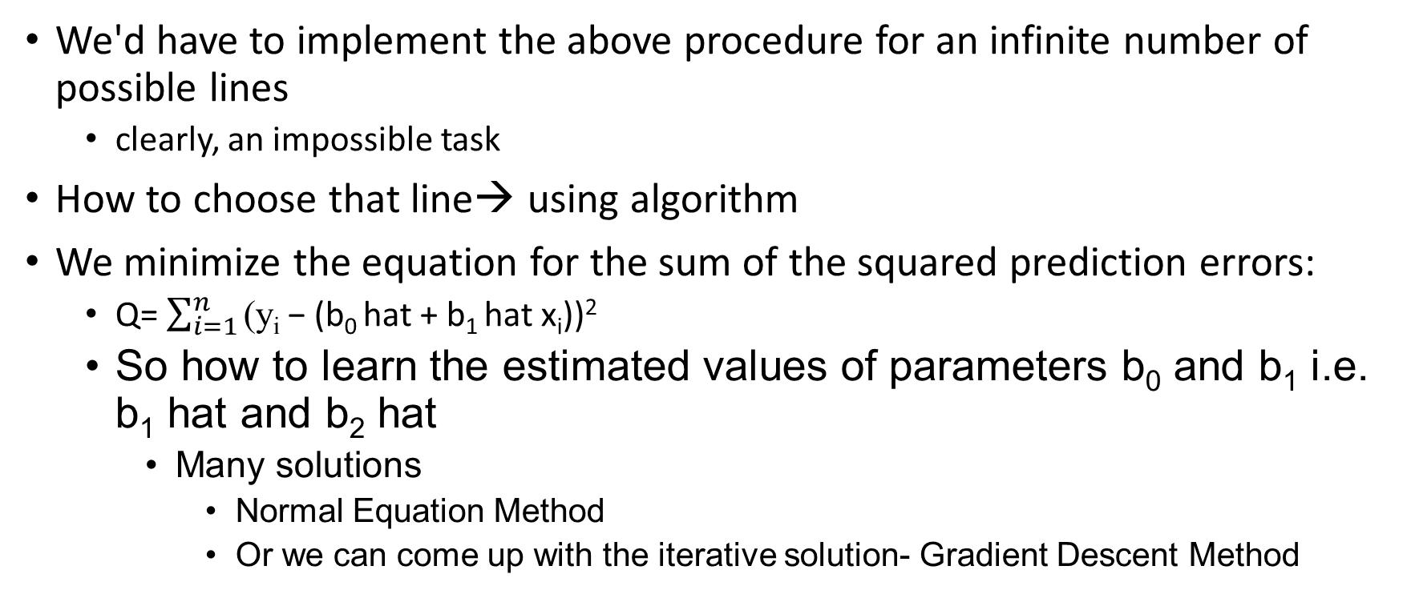
Infinite possible lines- Solution?

Slide 12
Normal Method
The least square estimator of b₀ and b₁ i.e. b₀ hat and b₁ hat must satisfy normal equations: S= Sum(y_{i}-b₀ hat-b₁ hat x_{i})²
  ∂S/ ∂b₀= -2 (y_{i}-b₀ hat-b₁ hat x_{i}) = 0
  ∂S/ ∂b₁= -2 x_{i}(y_{i}-b₀ hat-b₁ hat x_{i}) = 0
So the estimator b₀ hat and b₁ hat are solutions of the equations

Slide 13
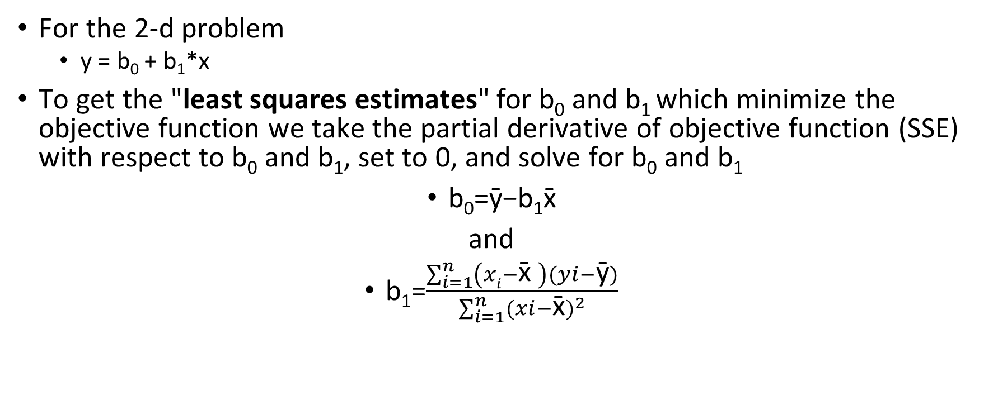
Normal Method

Slide 14
Slope
Denominator of slope equation is necessarily positive since
  it only involves summing positive terms.
Therefore, the sign of the slope b1 is solely determined by the numerator.
The numerator tells us, for each data point, to sum up the product of two distances
  the distance of the x-value from the mean of all of the x-values and
  the distance of the y-value from the mean of all of the y-values.

Slide 15
Numerator- Positive and Negative cases
x̄ = 6.5
+ve distance
+ve distance
So multiplication of x_{i}-x̄ and y_{i}- ȳ will always be positive.
-ve distance
ȳ = 11.7
-ve distance
-ve distance
x̄ = 6.5
+ve distance
So multiplication of x_{i}-x̄ and y_{i}- ȳ will always be negative.
-ve distance
ȳ = 8.5
+ve distance

Slide 16
Assumptions of a linear regression
Linearity
  There must be a linear relationship between the outcome variable and the independent variables.
Homoscedasticity
  refers to a condition in which the variance of the residual, or error term, in a regression model is constant.
  That is, the error term does not vary much as the value of the predictor variable changes.
Multivariate normality
  Multiple regression assumes that the residuals are normally distributed.
Independence of errors
Lack of (No) multicollinearity
  Multiple regression assumes that the independent variables are not highly correlated with each other. This assumption is tested using Variance Inflation Factor (VIF) values.

Slide 17
Pros and Cons
Works on any size of dataset, gives information about relevance of features
The Linear Regression Assumptions need to be checked

Slide 18
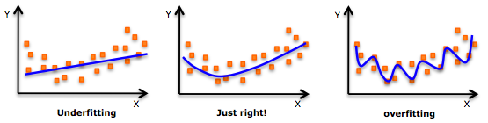
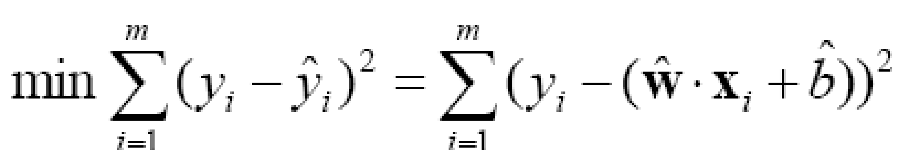


Linear Regression
To avoid over-fitting, a regularization term can be introduced (minimize a magnitude of w)
Lasso
Ridge Regresssion

Slide 19
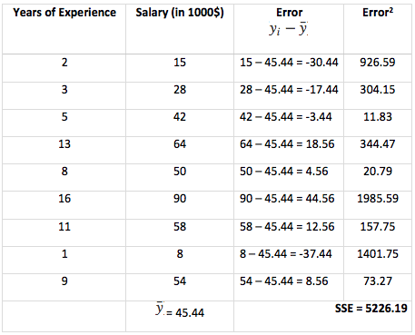
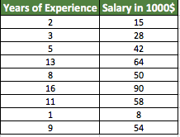
The sum of squared errors SSE output is 5226.19. To do the best fit of line intercept, we need to apply a linear regression model to reduce the SSE value at minimum as possible.

Slide 20

To identify a slope intercept, we use the equation
y = mx + b,
‘m’ is the slope
‘x’ → independent variables
‘b’ is intercept
We will use Ordinary Least Squares method to find the best line intercept (b) slope (m)

Slide 21
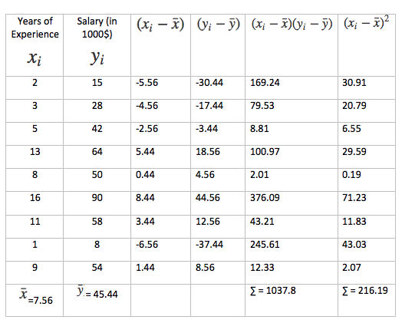
We need to calculate slope ‘m’ and line intercept ‘b’. Below is the simpler table to calculate those values.
m = 1037.8 / 216.19
m = 4.80
b = 45.44 - 4.80 * 7.56 = 9.15
Hence, y = mx + b → 4.80x + 9.15
y = 4.80x + 9.15

Slide 22
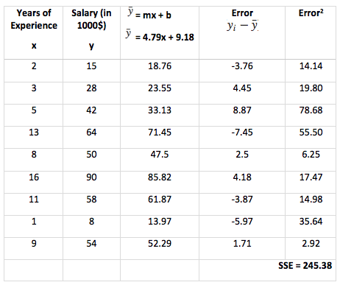
Let us calculate SSE again by using our output equation.
Now Sum of Squared Error got reduced significantly from 5226.19 to 245.38.

Slide 23
Low variability
In general, independent variables need some variability in order to be good predictors in a model.
For instance, an underrepresented category in a variable (for example 195 non-smokers versus 5 smokers) is, in most cases, a good reason to remove the variable from the model. Although sometimes these variables can still be useful, for instance, when the outcome is lung cancer, even a highly skewed smoking variable may still be a good predictor.
Variability should be considered together with the importance of the variable to decide whether to exclude it or not from the model.

Slide 24
Importing the libraries
Importing the dataset
Splitting the dataset into the Training set and Test set
Training the Simple Linear Regression model on the Training set
Predicting the Test set results
Visualising the Training set results
Visualising the Test set results
Making a single prediction (for example the salary of an employee with 12 years of experience)
Getting the final linear regression equation with the values of the coefficients

Slide 25
Importing the libraries
import numpy as np
import matplotlib.pyplot as plt
import pandas as pd

Slide 26
Importing the dataset
dataset = pd.read_csv('Salary_Data.csv')
X = dataset.iloc[:, :-1].values
y = dataset.iloc[:, -1].values
YearsExperience | Salary
1.1 | 39343
1.3 | 46205
1.5 | 37731
2 | 43525
2.2 | 39891
2.9 | 56642
3 | 60150
Total -30 Rows…

Slide 27
Splitting the dataset into the Training set and Test set
from sklearn.model_selection import train_test_split
X_train, X_test, y_train, y_test = train_test_split(X, y, test_size = 1/3, random_state = 0)

Slide 28
Training the Simple Linear Regression model on the Training set
from sklearn.linear_model import LinearRegression
regressor = LinearRegression()
regressor.fit(X_train, y_train)

Slide 29
Predicting the Test set results
y_pred = regressor.predict(X_test)

Slide 30
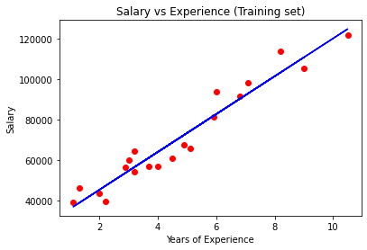
Visualizing the Training set results
plt.scatter(X_train, y_train, color = 'red')
plt.plot(X_train, regressor.predict(X_train), color = 'blue')
plt.title('Salary vs Experience (Training set)')
plt.xlabel('Years of Experience')
plt.ylabel('Salary')
plt.show()

Slide 31
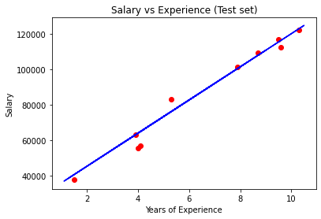
Visualising the Test set results
plt.scatter(X_test, y_test, color = 'red')
plt.plot(X_test, regressor.predict(X_test), color = 'blue')
plt.title('Salary vs Experience (Test set)')
plt.xlabel('Years of Experience')
plt.ylabel('Salary')
plt.show()

Slide 32
Making a single prediction (for example the salary of an employee with 12 years of experience)
print(regressor.predict([[12]]))
output
  [138967.5015615]
Note:
  12- scalar
  [12]- 1D Array
  [[12]]- 2D Array

Slide 33
Getting the final linear regression equation with the values of the coefficients
print(regressor.coef_)
print(regressor.intercept_)
Output
  [9345.94244312]
  26816.192244031183
Thus,
  Salary=9345.94×YearsExperience+26816.19
Note: coef_ and intercept_ are attributes of LinearRegression.

